Slide 1
Creating Page Layouts w/CSS: Flex
CSCI 185, Spring 2023 Intro to Computer Programming for the Web

Slide 2
Announcements
HW4 Posted (due next Monday)
Tutorial 5 will involve getting started w/HW4 and completing at least 3 tasks (since it’s a longer homework).
If you submit your tutorial before class on Friday, you don’t have to attend! Class time will be used to answer questions.
After today, we’ll be transitioning to design (with an eye to accessibility).
Assignments will be more open-ended, and you’ll get to choose what you work on.

Slide 3
Outline
Intro to CSS Flexbox
Aligning containers horizontally and vertically

Slide 4
Outline
Intro to CSS Flexbox
Aligning containers horizontally and vertically

Slide 5
Flex v. Grid
CSS Grid: Gives you control over how to precisely position your boxes (grid items) on the screen in 2-dimensional space (columns and rows).
Flex:
Used when you have many child containers that you want to flow within a parent container.
Lets you specify a few generic rules that will control how the children of a container are positioned
More here: Grid v. Flexbox: Which to use when?

Slide 6
Using Flexbox: Suggested Strategy
Parent Container Put the display into “flex mode” display: flex and then use the following properties to align the child items:
align-items: (flex-start, flex-end, space-around, space-between, center)
justify-content: (same as align-items)
flex-direction: (row, column, row-reverse, column-reverse)
flex-wrap: (no-wrap, wrap, wrap-reverse)
Child Container
Apply sizing to the child container as needed, using the box model (padding, margin, width, height, border).

Slide 7
Flexbox Froggy

Slide 8
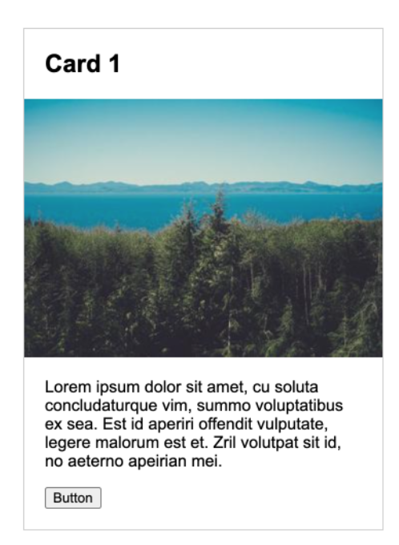
Exercise 1: Style and Center the Card
Part 1 (Use the Box Model)
Open 01-style-and-center-the-card
Adjust the width of the card to be 25% of the parent (main’s) width.
Give the card a border.
Style the h2, p, and button elements so that they’re spaced away from the border of the container.
Make the image fit inside of the the card exactly
Part 2 (Use Grid)
Center the card horizontally and vertically within the parent (body) element.
To do this, put the parent container’s display into flex mode and set the justify-content and align-items properties.

Slide 9
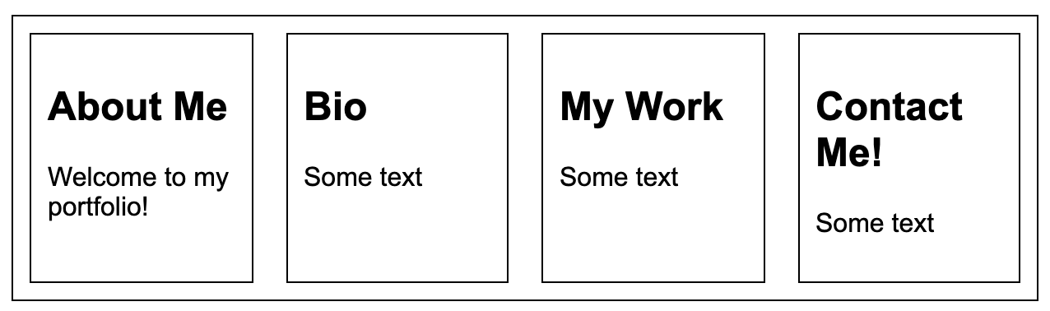
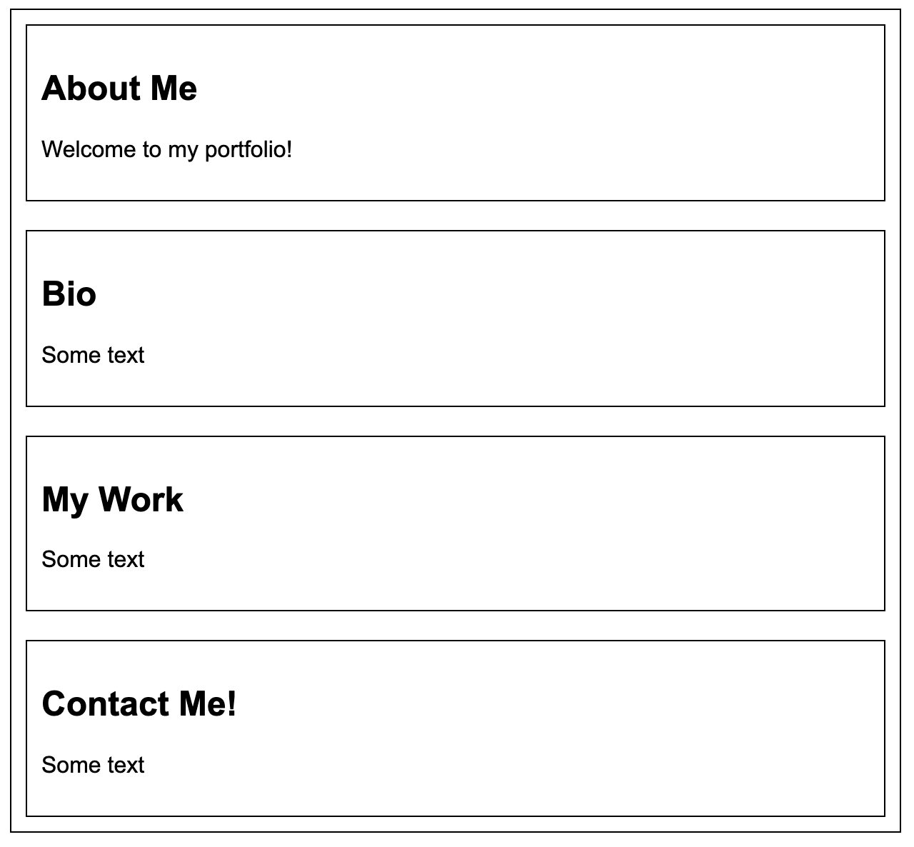
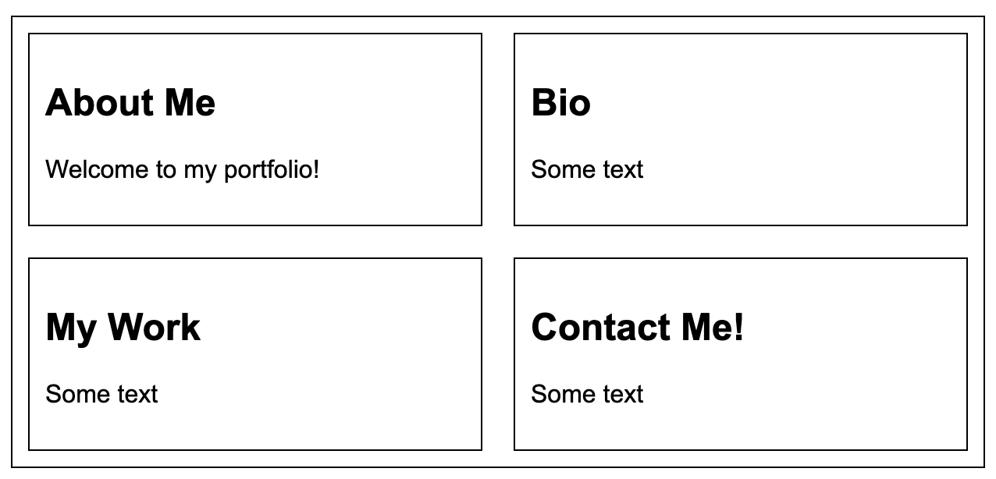
Flexbox: Practice 2
Open 02-flexbox-wrapping. Can you create the following layouts?
1
3
2

Slide 10
Flexbox: Practice 1 Cont’d – Using Media Queries
Make it so that #1 is for Desktop screens, #2 is for Tablet, and #3 is for Mobile
1
3
2

Slide 11
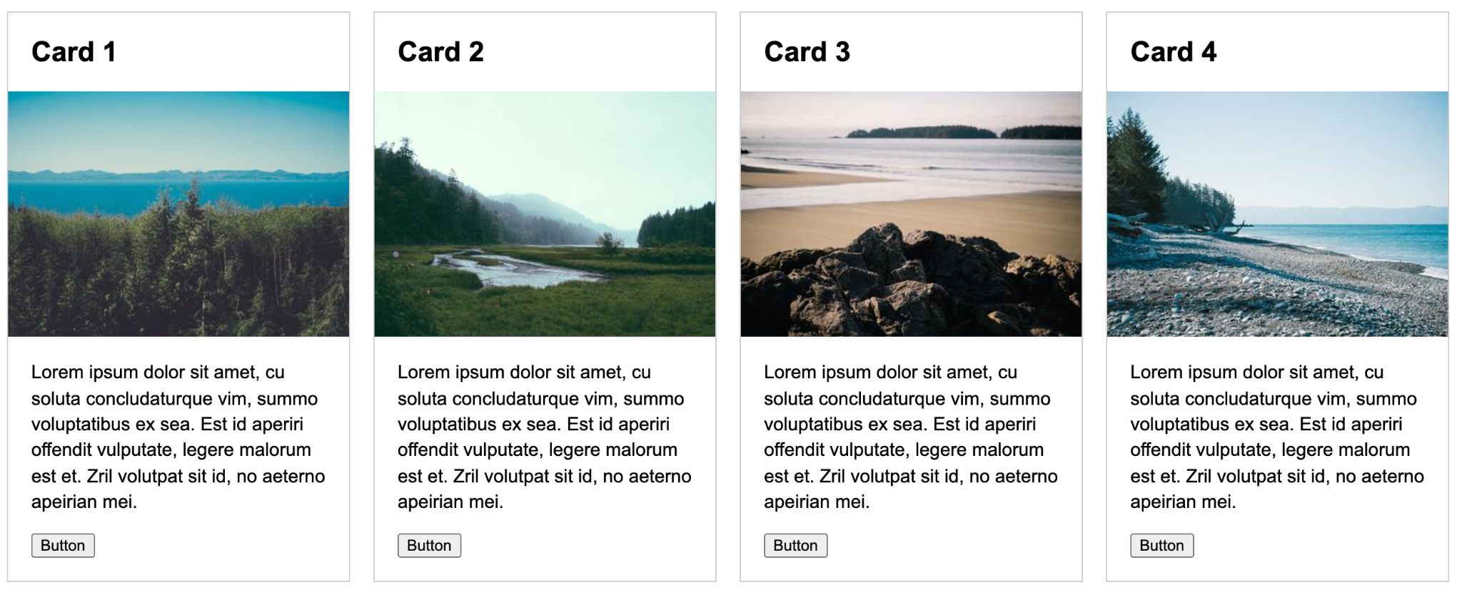
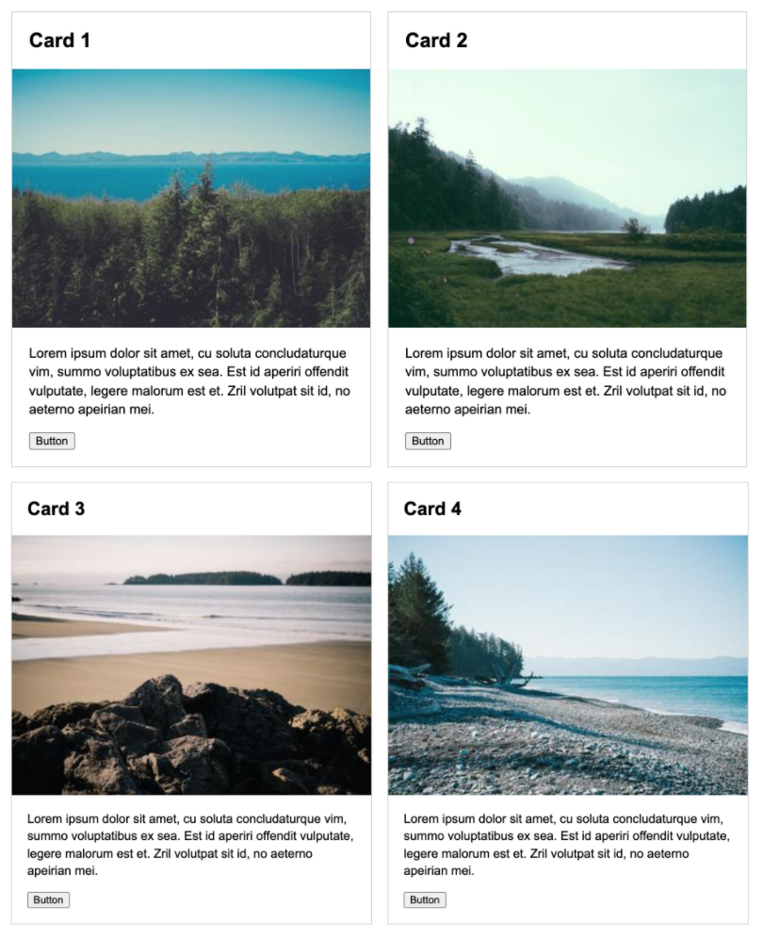
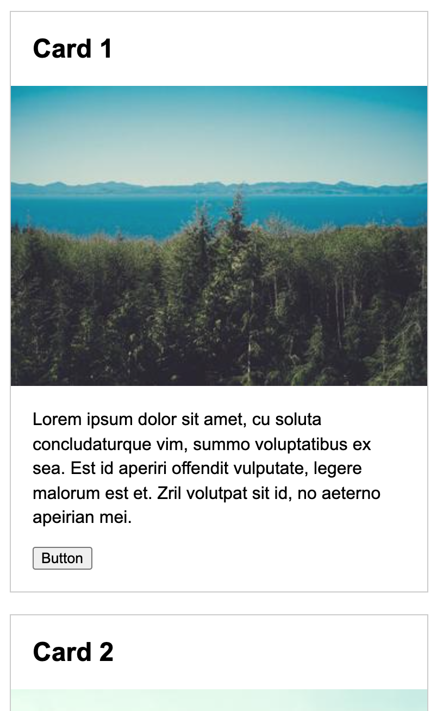
Flexbox: Practice 2 (on your own)
Open 03-flexbox-media-queries and create these screens:
Desktop
Tablet
Mobile

Slide 12
Flexbox: Navigation Bar
Open 04-nav-bar, and try to make the following:

